Slide 1


Silicon Prairie Gencyber
Numbering Systems

Slide 2
Overview
What is a numbering system
Why do we use them
What are some common numbering systems in cyber
Conversions
Find your group

Slide 3

Cybersecurity First Principles
Domain Separation
Process Isolation
Resource Encapsulation
Least Privilege
Layering
Abstraction
Information Hiding
Modularity
Simplicity of Design
Minimization

Slide 4
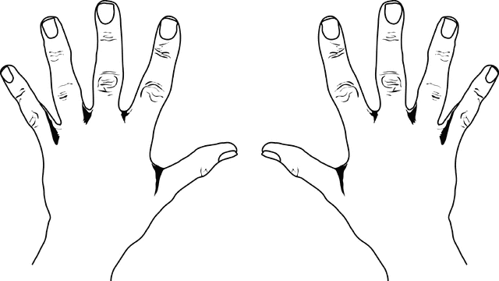
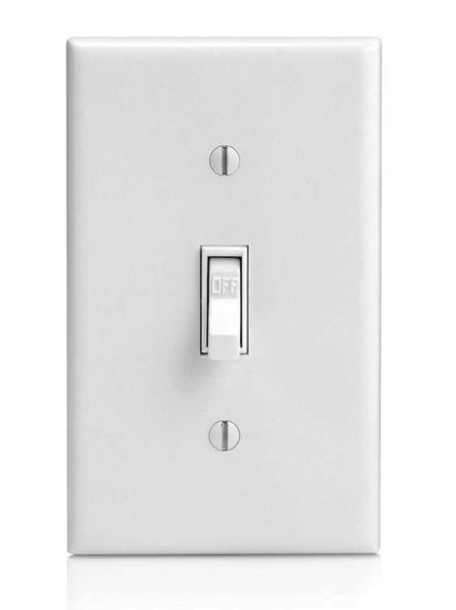
What is a Number System Base
Base 2
Base 10

Slide 5
The Martian
Communicating with Earth
Reprogramming Rover

Slide 6
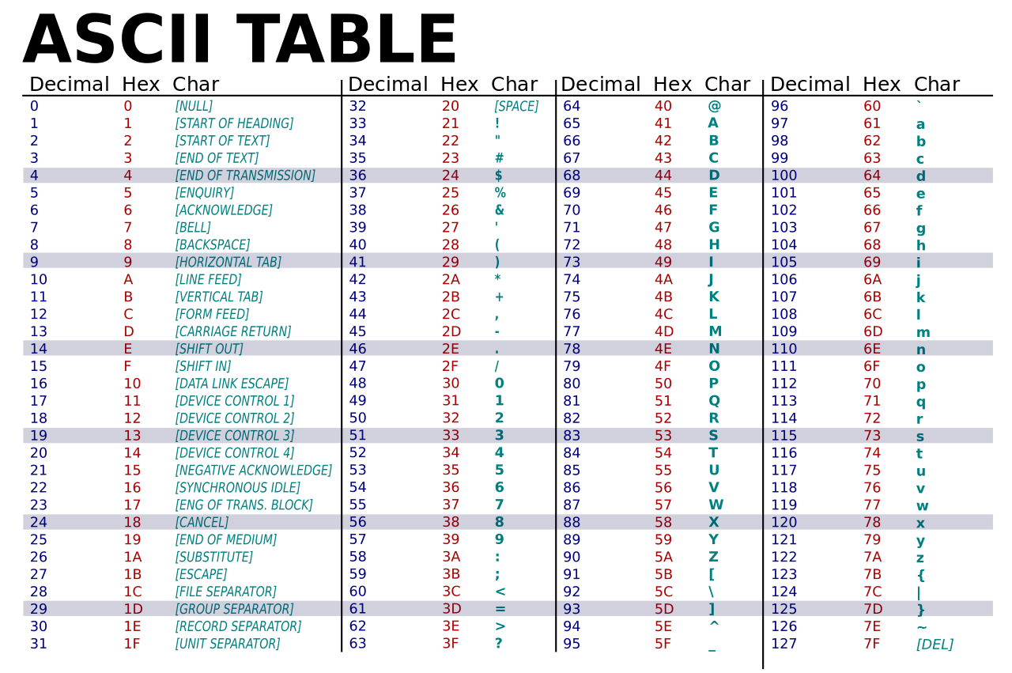

Slide 7
IP Addressing
Computer speak (binary)
00001010.00000001.00010111.00010011
Human speak (decimal)
10. 1. 23. 19

Slide 8
*NIX Permissions
-rw-rw-r-- 1 pi pi 8612 Jan 27 2015 filename.py
110 110 100
-rwxrw-r-- 1 pi pi 8612 Jan 27 2015 filename.py
111 110 100
7 6 4
chmod 764 filename.py

Slide 9
All the Same
Binary: 111111000₂
=
Decimal: 2016₁₀
Octal: 3740₈
Hexadecimal: 7e0₁₆or 0x7e0

Slide 10
Converting Between Systems
Binary and Decimal
2⁷ 2⁶ 2⁵ 2⁴ 2³ 2² 2¹ 2⁰
0 0 0 0 0 0 0 0

Slide 11
Converting Between Systems
Octal and Binary
Work in groups of three binary digits
011000010
011 000 010
3 0 2

Slide 12
Converting Between Systems
Hex | Binary
0 | 0000
1 | 0001
2 | 0010
3 | 0011
4 | 0100
5 | 0101
6 | 0110
7 | 0111
8 | 1000
9 | 1001
A | 1010
B | 1011
C | 1100
D | 1101
E | 1110
F | 1111
Hex and Binary
Work in groups of
four binary digits

Slide 13
Silicon Prairie Gencyber
Find Your Groups!

